Slide 2
Overview
Part 1 – Registers, Microoperations and Implementations
Part 2 – Counters, Register Cells, Buses, & Serial Operations
Part 3 – Control of Register Transfers
  Introduction to register transfer systems
  Register transfer system design procedure
  A design example
  Microprogrammed control

Slide 3
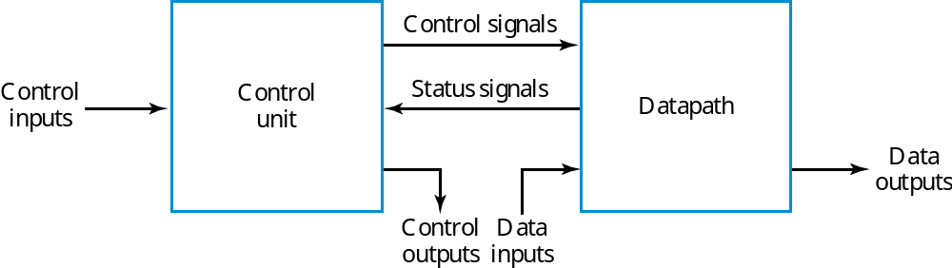
Introduction to Register Transfer Systems
Datapath and Control Unit
  Set of registers, mostly in Datapath with some in Control Unit
  Register transfers performed on registers
  Control that supervises the sequencing of the register transfers

Slide 4
Programmable and Non-Programmable Systems
Programmable System – a portion of the input consists of a sequence of instructions called a program, typically stored in a memory and addressed by a program counter. The Control Unit is responsible for fetching and executing these instructions.
Non-programmable System – the control unit does not deal with fetching and executing instructions, but contains all of the information for sequencing register transfers based on inputs and on status bits from the datapath.
Only non-programmable designs are considered here.

Slide 5
Register Transfer System Design Procedure
Write a detailed system specification
Determine all data, control and status input signals, all data, control and status output signals, and registers of the datapath and control unit.
Find a state machine diagram for the system including register transfers for the datapath and control unit as outputs.
Determine all internal control and status signals. Use these signals to separate output conditions and actions, including register transfers, from the state machine diagram flow and represent them in tabular form.
Draw a block diagram of the datapath including all control and status inputs and outputs. Draw a block diagram of the control if it includes register transfer hardware.
Design any specialized register transfer logic as needed for the datapath and the control.
Design the control unit logic.
Verify the correct operation of the combined datapath and control unit. If verification fails, debug the system and verify the changed system.

Slide 6
Design Example – DASHWATCH - Specs
Very Inexpensive Stop Watch for “dash” runners
Times intervals to at most 99.99 seconds
Stopwatch action plus storage of best performance time per session (session ended by turning off power or pushing RESET)
Inputs START, STOP, CSS (compare and store shortest), RESET
Registers: 4-digit BCD Counter and 16-bit Parallel Load Register
Output: 4 digit BCD LCD with decimal point

Slide 7
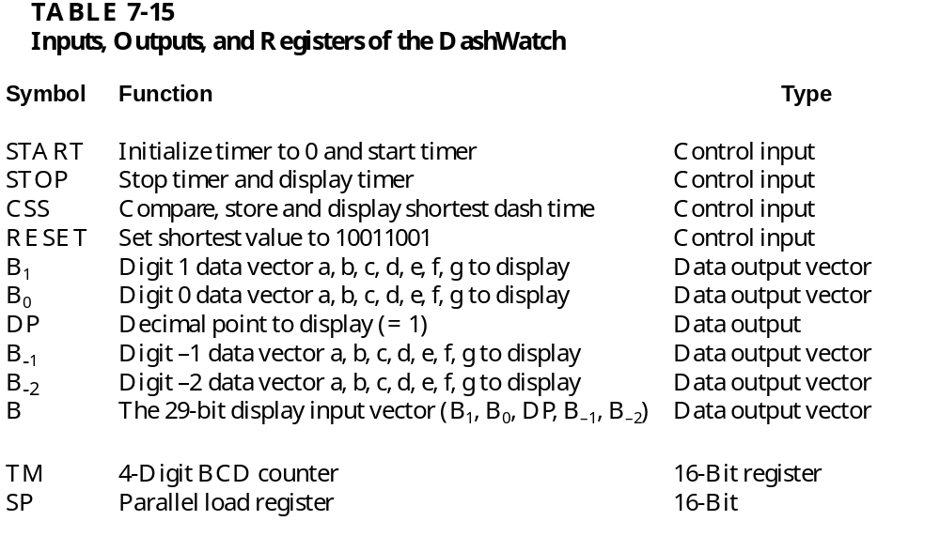
DASHWATCH Inputs, Outputs, and Registers
SD

Slide 8
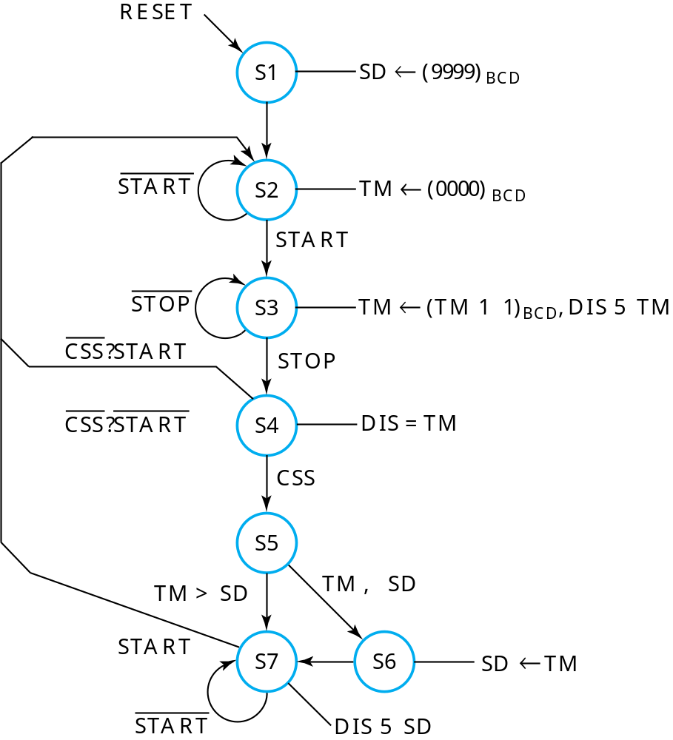
DASHWATCH State Machine Diagram with Register Transfer Outputs

Slide 9
State Machine Diagram Design
Specify only Moore outputs (no particular reason)
S1: Reset state - in this state, initialize SD to 1001100110011001 (99.99), the maximum possible dash time.
S2: Because of Moore output spec, S1 cannot be used for this state since SD is not to be initialized again to 99.99 after having passed through states S4 or S7. TM is initialized to (0000)_{BCD} for next dash.
S3: State during dash. Entered with START and exited with STOP. While in state, 1 (0.01 seconds) is added to TM for each clock pulse. (Clock frequency is 100 Hz), and DIS shows TM value.
S4: Decision state whether to Compare, Store, and display Shortest dash time, or to continue to display TM. Also START begins new dash.
S5: State for comparison of TM to SD.
S6: State for loading TM into SD if TM is smaller.
S7: State for START to begin new dash and display of SD as shortest dash time.

Slide 10
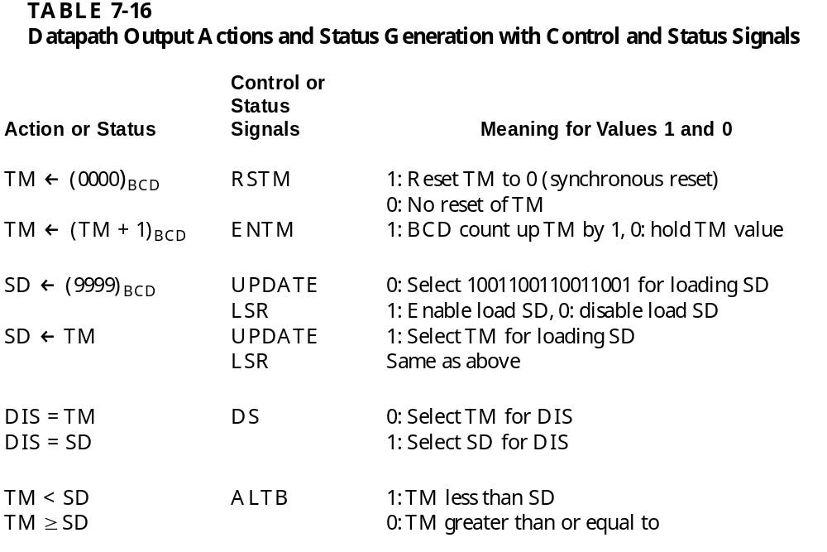
DASHWATCH Output Control/Status Table

Slide 11
Determination of Internal Control/Status Signals
TM – Timer
  Reset to 0000: RSTM
  Enable to Count Up: ENTM
SD – Shortest Dash
  Load SD: LSR = 1;
  Select input 9999: UPDATE = 0
  Select input TM: UPDATE = 1
DIS – Display (B₁, B₀, DP, B_{– 1}, B_{– 2})
  Select input TM: DS = 0
  Select input SD: DS = 1
Compare TM and SD (Status)
  TM < SD: ALTB = 1
  TM ≥ SD: ALTB = 0

Slide 12
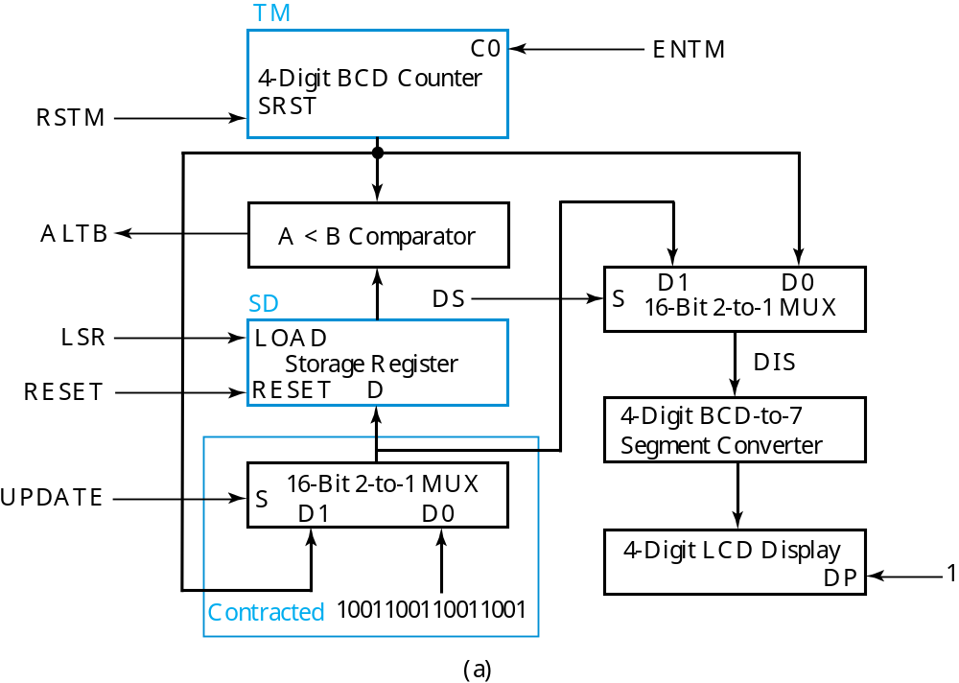
DASHWATCH Datapath

Slide 13
DASHWATCH – Datapath Development
TM: 4-digit BCD Counter with Synchronous Reset
  Based on previous BCD adder digit design
  synchronous reset SRST added
  SRST = RSTM
  C0 (Incoming carry) = ENTM
A < B Comparator
  Compares TM to SD
  Designed as left-to-right iterative cell array with output C0
SD: Standard 16-bit parallel load register
  LOAD = LSR
  Contracted standard 2-way, 16-bit multiplexer used to select between 9999_{BCD} and TM as parallel load input D
  S = UPDATE

Slide 14
DASHWATCH – Datapath Development – Display Logic
2-way 16-bit multiplexer
  Selects between TM and SD
  S = DS
4-digit BCD-to-7 Segment Converter
  Uses previous design
4-digit 7-Segment Display with Decimal Point
  2-digit fractional part
  Decimal Point control = DP
  DP = 1

Slide 15
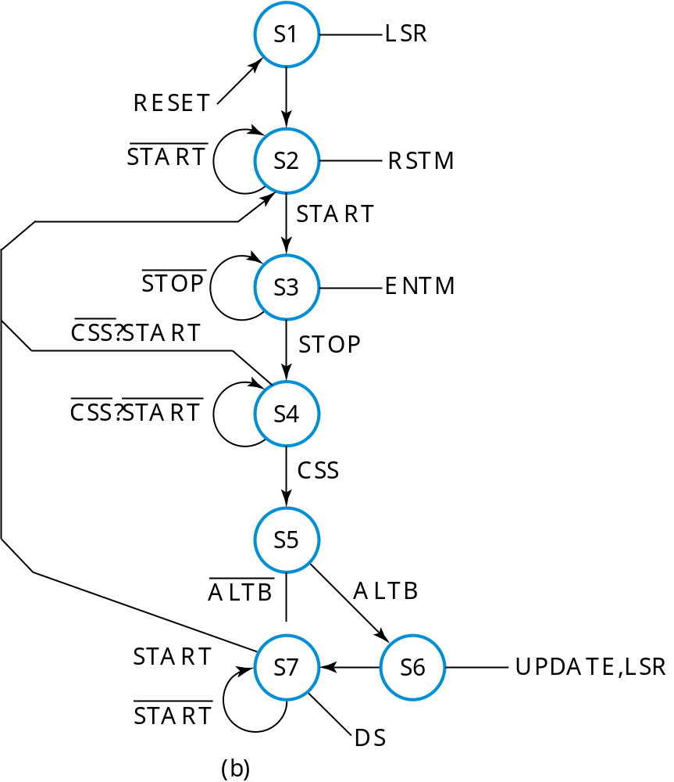
DASHWATCH – SMD with Control Signal Outputs Replacing Register Transfers

Slide 16
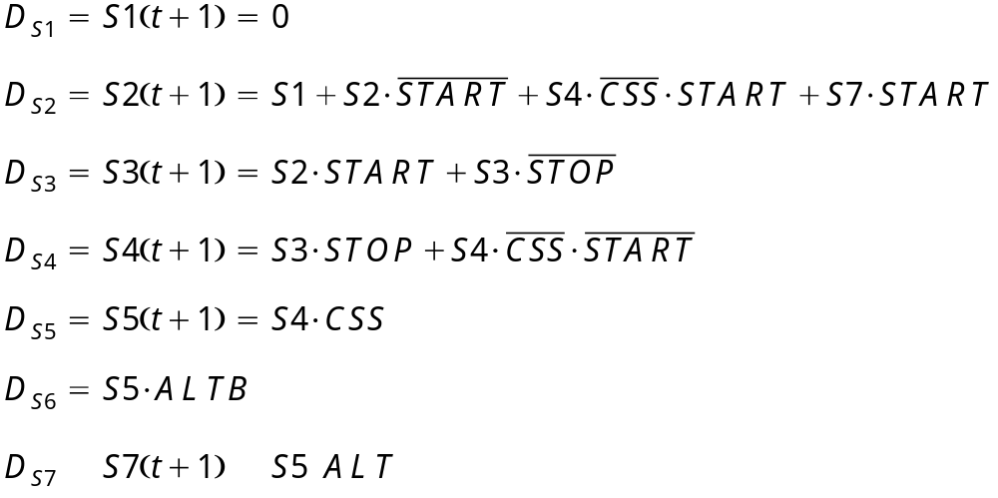
DASHWATCH – FF Input Equations
One-Hot State Assignment – 7 bits
State S1 entered only by using asynchronous RESET

Slide 17
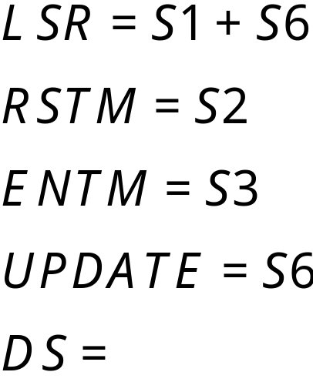
DASHWATCH – Output Equations

Slide 18
Microprogrammed Control
Microprogrammed Control — a control unit with binary control values stored as words in memory.
Microinstructions — words in the control memory.
Microprogram — a sequence of microinstructions.
Control Memory — RAM or ROM memory holding the microinstructions.
Writeable Control Memory — RAM Memory into which microinstructions may be written

Slide 19
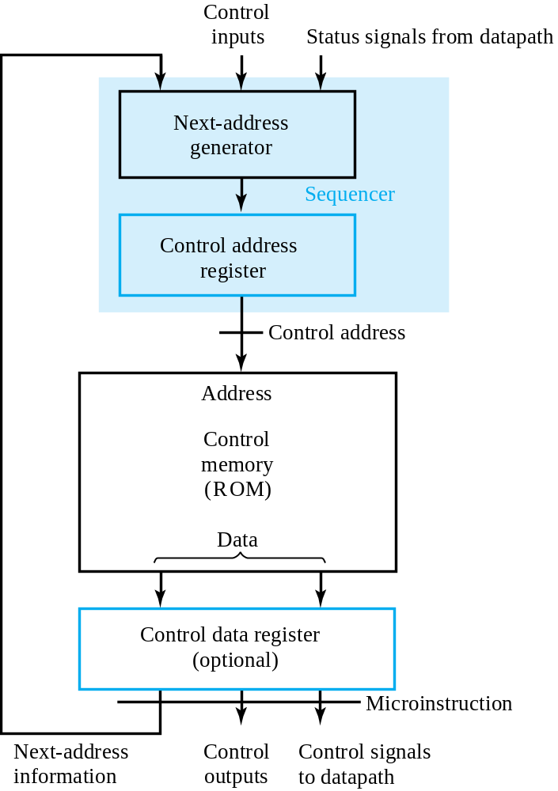
Microprogrammed Control (continued)

Slide 20
Terms of Use
All (or portions) of this material © 2008 by Pearson Education, Inc.
Permission is given to incorporate this material or adaptations thereof into classroom presentations and handouts to instructors in courses adopting the latest edition of Logic and Computer Design Fundamentals as the course textbook.
These materials or adaptations thereof are not to be sold or otherwise offered for consideration.
This Terms of Use slide or page is to be included within the original materials or any adaptations thereof.

